Slide 1
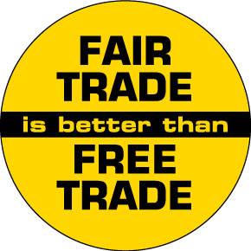
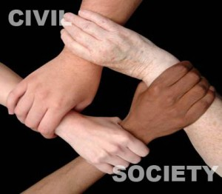
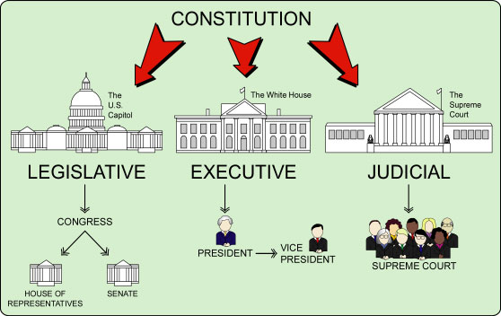
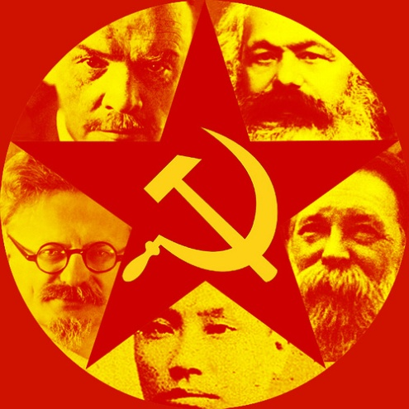
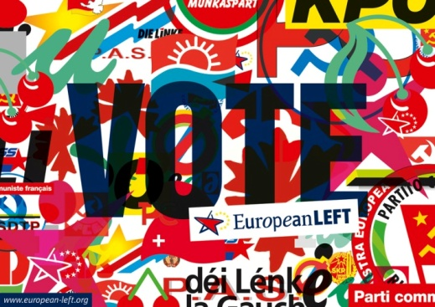
MORE AP COMPARATIVE GOVT THEORY
Covering the
6 Major Topics
Presentation based on Ethel Wood’s
APCG&P: An Essential Coursebook & Study Guide, 3rd Edition

Slide 2
SIX MAJOR TOPICS
TOPIC ONE: THE COMPARATIVE METHOD
TOPIC TWO: SOVEREIGNTY, AUTHORITY & POWER
TOPIC THREE: POLITICAL AND ECONOMIC CHANGE
TOPIC FOUR: CITIZENS, SOCIETY & THE STATE
TOPIC FIVE:POLITICAL INSTITUTIONS
TOPIC SIX: PUBLIC POLICY

Slide 3
TOPIC ONE: Comparative Method
Quantitative analysis focuses on empirical data based on factual statements and statistics
Ex:Comparing economic development of a group of countries by comparing statistics such as GDP, per capita PPP, imports vs. exports, etc.
Qualitative analysis focuses on normative issues that require value judgments.
Ex: Look at statistics but focus on whether these bode well or ill for the countries in question.
We need both approaches to analyze & compare poltical systems.

Slide 4
POLITICAL SCIENCE: Using the Scientific Method
Researchers use data to make a hypothesis
Independent variables & Dependent variables
Ex: HYPOTHESIS: Low levels of formal education (independent variable) might lead to higher poverty rates (dependent variable).
Correlation vs. Causation
Correlation: change in one variable coincides with change in the other, causality MAY be present, but not necessarily
Causation: Change in one variable CAUSES change in the other.

Slide 5
THREE WORLD APPROACH
Based on Cold War politics
FIRST WORLD: US & Allies
SECOND WORLD: USSR & Allies
THIRD WORLD: nations tha tdidn’t fit into the first two categories and were generally economically underdeveloped and deprived.
Despite end of Cold War, this approach is still used today to an extent.
Other comparisons: Democracy vs. Authoritarianism or Communism vs. Capitalism

Slide 6
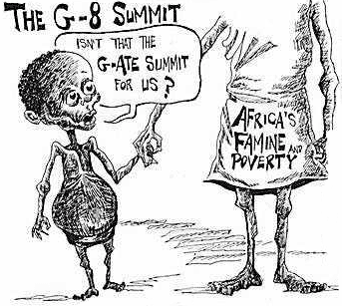
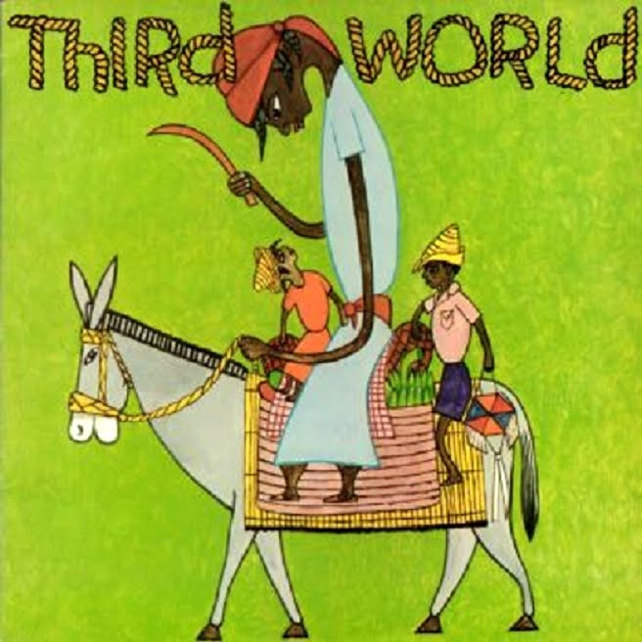

Slide 7
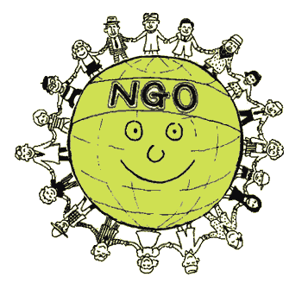
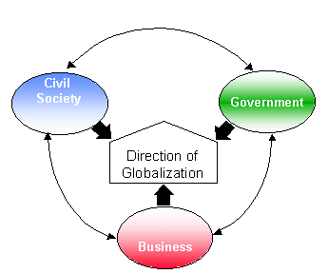
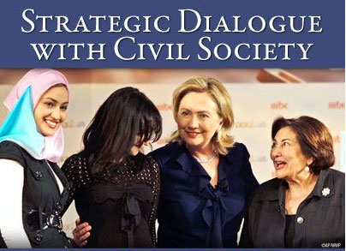
New comparative trends: Informal Politics
Govts have formal positions, structures and insitutions you can see on an org chart.
UK (Prime minister, House of Lords, House of Commons) vs. USA (President, Senate, House of Representatives)
Deeper understanding comparing civil society (the way that citizens organize and define themselves & their interests)
INFORMAL POLITICS: looks at how politicians operate outside of their formal powers, and how the beliefs, values and actions of ordinary citizens impact policymaking

Slide 8
New comparative trends: Political Change
No longer ruled by Cold War and two superpowers
Look at the impact of change on different countries
Globalization trends
Democratization
Trade liberalization
Resurgence of ethnic identities, etc.

Slide 9
New comparative trends: Integration of Political-Economic Systems
This goes beyond capitalism and communism...we need to look at how economic systems influence politics.
Attitudes and behavior of citizens affected by economic inefficiency, economic inequality, and decision-making→ they turn to government for solutions...if no solutions, then what?

Slide 10
Three New Groups
“Advanced” Democracies: well-established democratic governments and high level of economic development (Ex:Great Britain)
Communist & Post-Communist countries: have tried to create a system that limits individual freedoms in order to divide wealth more equally. Now are dealing with changes to their regimes (Ex: China & Russia)
LDCs (Less developed countries) & NICs (newly industrializing countries):
LDCs lack significant economic development, tend to have authoritarian governments, not always. (Ex: Nigeria)
NICs: experiencing rapid economic growth and have shown tendency toward democratization and political and social stability. (ex: Mexico & Iran)

Slide 11
TOPIC TWO: SOVEREIGNTY, AUTHORITY & POWER
State: Weber→organization that maintains a monopoly of violence over a territory (control what happens in their borders, define who can and cannot use weapons, sets the rules, also institutions of the state).
Sovereignty: ability to carry out actions or policies within their borders independently from interference either from the inside or outside.
Institutions: stable, long-lasting organizations that help turn political ideas into policy (bureaucracies, legislatures, judicial systems, political parties).

Slide 12
STATES, NATIONS, REGIMES
Nation: gourp of people tha is bound together by a common political identity
Nationalism: sense of belonging and identity that distinguishes one nation from another
Patriotism: resulting pride and loyalty individuals feel towards their nations
For over 200 years, the nation had provided overriding identity for most of its citizens
Now, globalization and fragmentation provide counter-trends to nationalism
Regime: rules that a state sets and follows in exerting its power (some are democratic, some are authoritarian)

Slide 13
DEMOCRACIES
Goverment by the people, type of regime that bases its authority on the will of the people
Indirect democracy: elected officials representing the people
Direct democracy: individuals have immediate say over lots of decisions govt makes
3 branches: executive, legislative, judicial (constitutional courts)
Parliamentary systems vs. Presidential systems
Democracies vary the degree to which the govt regulates the economy

Slide 14
Parliamentary Systems
Parliamentary sovereignty governs decision-making process.
Legislature makes the laws, controls finances, appoints and dismisses Prime Minister and cabinet, debates public issues... Reality is cabinet initiates legislation and makes policy, uses party discipline to ensure majority party passes bills proposed by leadership
FUSION of POWERS (leg & exec branches fused together bc PM and cabinet are leaders of majority party in legislature)
Head of state: role that symbolizes power & nature of regime (Ex: Queen-Britain)
Head of government: role that deals with everyday tasks of running government (Ex: Prime Minister-Britain)

Slide 15
Presidential Systems
Head of state and government→ PRESIDENT
Directly elected by people as chief executive
Separation of Powers between branches ensures that power is shared and that one branch doesn’t dominate others
Checks and balances put in place to ensure separation of powers
Result: power is diffused and policymaking process often slowed down bc one branch may question decisions
For it to work, each branch must have independent base fo authority recognized nad respected by politicians and the public
Ex: Mexico, Nigeria, USA

Slide 16
Mixed Systems
Semi-Presidential System: combination of presidential and parliamentary systems.
PM coexists with a president who is directly elected by the people and who hols a significant degree of power
Ex: Russian president has disproportionate amount of power to PM, France and India→ power balance between 2 executives is different

Slide 17
AUTHORITARIAN REGIMES
Decisions are made by political elites (those that hold power) without input from citizens.
Can be single dictator, hereditary monarch, small oligarchy/aristocracy, single political party
Some authoritarian regimes based on communism, bc communist party controls everything from the government to the eocnomy to social life
Some practice state corporatism—where govt officials interact with people/groups outside govt before they set policy (usually business and labor leaders) or they may be heads of huge patron client systems that have reciprocal favors and services in turn for support.

Slide 18
AUTHORITARIAN REGIMES
A small group of elites exercising power over state
Citizens with little or no input into selection of leaders & government decisions
No constituttional responsibility of leaders to the public
Restriction of civil rights and liberties
CAREFUL: authoritarianism does not equal lacking legitimacy. If people accept right to rule and leader’s authority then they are legitimate!

Slide 19
TOTALITARIANISM
AUTHORITARIANISM DOES NOT EQUAL TOTALITARIANISM
Usually has more negative connotations, used to describe repressive, detested regimes (i.e. Stalinist USSR, China during Cultural Revolution)
Control and transform ALL aspects of the political and economic systems of the society
Usually have a strong ideological goal such as communism (that some authoritarian govts lack)
Not afraid to use VIOLENCE

Slide 20
MILITARY REGIMES
Military rule: prevalent form of nondemocratic rule in Latin America, Africa and parts of Asia.
When legitimacy and/or stability of the state is in question, the military often intervenes directly in politics as the organization that can solve the problem
Begins with a COUP D’ÉTAT, forced takeover of the government
Sometimes have popular support, once in power military usually restricts civil rights and liberties in the name of order and keeps political parties from forming or real elections from taking place
Usually lacks specific ideology, leaders often have no charismatic or traditional legitimacy so they work with state bureaucracy to form regime
Sometimes precedes democracy (like a transition such as in South Korea and Taiwan in the 1990s), other times one coup after another, weakening the state (praetorianism as in Nigeria)

Slide 21
CORPORATISM
Method where business, labor and other interest groups bargain with the state over economic policy
STATE CORPORATISM: Emerged as a way for authoritarian regimes to control public by creating orgs to represent the interests of the public…sanctions some groups and eliminates input from groups not recognized or created by state (i.e. MEXICO under the PRI)
Provides public limited influence in policymaking process, interest groups funded and managed by the state
COOPTATION!!!!

Slide 22
CORPORATISM /CLIENTELISM in Authoritarian & Democratic Regimes
PATRON CLIENTELISM: a system in which the state provides specific benefits or favors to a single person or small group in return for public support
Relies on individual patronage rather than organizations…(Ex. Mexico, Nigeria, Iran, etc.
PARASTATALS: state owned or semi-owned businesses (Ex: PEMEX, PETROBRAS, etc.)
In democracies with nationalized industries→ directors are state officials advised by councils elected by major interest groups.
In democracies, industries may not be nationalized, but lots of regulatory decisions are made through direct cooperation between government agencies and interests (Ex: Scandinavian countries social & economic policies crafted through negotiations between interest groups and govt agencies, Costa Rica and Eco-turism)

Slide 23
PLURALISM & NEO-CORPORATISM
Pluralism: situation in which power is split among many groups that compete for the chance to influence the government’s decision-making...idea is that govt will react to citizen’s input.
Democratic pluralism
Formation of interest groups is spontaneous, grassroots
Dialogue between interest groups & state is voluntary and groups remain autonomous
Neo-Corporatism
Interest representation is institutionalized through recognition by the state, new groups can form only if the state allows it.
Institutionalized and legally binding links between groups and state agencies, so that groups are semi-public agencies acting on behalf of the state, not truly free.

Slide 24
INTEREST GROUPS
Organizations of like-minded people whose goal is to influence and shape public policy
Can be based on any type of common interest—occupations, labor, business interests, agriculture, community action or advocacy for a cause
Can be formally organized on a nation level or can work exclusively at local level
Can have non-political goals too
Independent interest groups are important force in maintenance of a strong civil society.

Slide 25
Strength of Interest Groups: Autonomy from the State
Authoritarian states, groups have almost no independence (Ex: China only govt endorsed groups can exist, govt cracks down on unrecognized groups.
Usually are agents to extend the party’s influence and shape citizen views→ TRANSMISSION BELTS that convey to their members the views of the party elite (No autonomy from state)
Western advanced democracies, usually have autonomous groups that compete with each other and with government for influence over policies→ INTEREST GROUP PLURALISM (Complete autonomy from state)
CORPORATISM (mixed autonomy): fewer groups compete, usually one for each interest sector (ex: labor, agriculture, management)
Group monopoly over its sector is officially approved by state→ State Corporatism
Interest groups take the lead and dominate state→ Societal Corporatism or Neo-Corporatism

Slide 26
LEGITIMACY: RIGHT TO RULE, as seen by citizens
TRADITIONAL LEGITIMACY: tradition should determine who should rule and how (myths, legends, rituals, ceremonies all reinforce traditional legitimacy)
Ex: monarchies, authority symbolized through crowns, thrones, family dynasties, etc.
CHARISMATIC LEGITIMACY: based on dynamic personality of a leader or small group, almost indefinable set of qualities that make people want to follow a particular leader, doesn’t survive its founder.
Ex: Jesus, Martin Luther King, Jr, Che Guevara or Fidel Castro, Mao Zedong, Napoleon (monarchy discredited, but force of personality & military talent allowed him to control France and conquer Europe)

Slide 27
LEGITIMACY (cont)
RATIONAL LEGAL LEGITIMACY: based on system of well-established laws or procedures (often a Constitution), highly institutionalized, carry over across generations of individual leaders. Based on the acceptance of the rule of law that supersedes the actions and statement of individual rulers
Ex: Bush election in 2000, most democratic governments, Dilma in Brazil, David Cameron in Britain, etc.
RULE OF LAW:
COMMON LAW: based on tradition, past practices and legal precedents set by interpretations of statutes, legal legislation, and past rulings. (Ex: UK, USA, countries with strong English influence)
CODE LAW: based on comprehensive system of written rules (codes) of law divided into commercial, civil and criminal codes (Ex: predominant in Europe and countries influenced by Spain, France, etc. China, Mexico, Russia have code law)

Slide 28
LEGITIMACY: Factors that contribute to legitmacy
In a democracy→ free and fair elections
In democratic and authoritarian regimes→
ECONOMIC WELL-BEING
HISTORICAL TRADITION / LONGEVITY
CHARISMATIC LEADERSHIP
NATIONALISM / SHARED POLITICAL CULTURE
SATISFACTION WITH THE GOVT’S PERFORMANCE OR RESPONSIVENESS

Slide 29
POLITICAL CULTURE
Collection of political beliefs, values, practices, and institutions that the government is based on. (Ex: if society values, individualism, the govt will usually reflect this value in the way it is structured and operates)
SOCIAL CAPITAL: amount of reciprocity and trust that exists among citizens, between citizens and the state.
Societies with low social capital→ tend to be authoritarian
Societies with high social capital→ tend to be inclined to democracy
CORRELATION or CAUSATION?
Islam & Confucianism could be seen as incompatible with democracy because they emphasize subservience and respect for differing statuses in life...
How do we explain democracy flourishing in Japan, India, South Africa and Turkey?

Slide 30
POLITICAL CULTURE
The basic norms for political activity in a society
Determining factor in what ideologies will dominate a country’s political regime
PARTICULARISTIC: Unique to a given country or group
Distinct from political attitudes and ideologies
SURVIVAL VALUES vs. SELF EXPRESSION VALUES
MASLOW’S HIERARCHY OF NEEDS
TRADITIONAL VALUES vs. SECULAR-RATIONAL VALUES

Slide 31
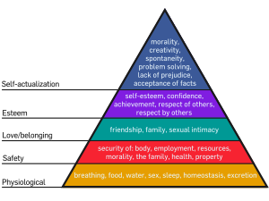
Maslow’s Hierarchy of Needs: How does this impact survival vs. Self-expression values?

Slide 32
WORLD CULTURAL VALUES

Slide 33
TYPES OF POLITICAL CULTURE
CONSENSUAL POLITICAL CULTURE: citizens may disagree on some political processes and policies, but they agree on how decisions are made, what issues should be addressed, how problems should be solved (Ex: agree elections should be held and accept the election winners as leaders)
Usually accept legitimacy of regime and solutions to major problems
CONFLICTUAL POLITICAL CULTURE: citizens are sharply divided on legitimacy of regime and solutions to major problems (Ex: if disagree on something as basic as capitalism v. Communism, conflict will happen or if religious differences are so pronounced that followers of one religion don’t accept elected leader from another religion, these differences divide country and threaten regime)
If a country is divided in political beliegs and values over a long time, political sub-cultures can delvelop that make it hard for government to rule effectively

Slide 34
POLITICAL IDEOLOGIES
Set of political values held by individuals regarding the basic goals of government and politics.
Exemplified by 5 dominant modern ideologies:
Liberalism
Communism
Social Democracy
Fascism
Anarchism
UNIVERSALISTIC, not specific to one country or time
Grand plan or idea to save society, make it better. Seen as rational alternatives to traditional sets of values like religion or spiritual notions of good and evil
Distinct from political attitudes and political culture

Slide 35
LIBERALISM as a political ideology
Emphasis on individual political freedom
IMPORTANT PART OF POLITICAL CULTURE FOR MODERN DEMOCRACIES
INDIVIDUAL FREEDOM OVER COLLECTIVE EQUALITY→
EQUALITY OF OPPORTUNITY over EQUALITY OF RESULT
Maximize freedom for all people, including freedom of speech, religion and association.
People have right to disagree with state decisions and challenge or act to change decisions of their leaders.
Emphasis on economic freedom
Weak state, little government intervention in the economy
Laissez-faire, Adam Smith
Entrepreneurialism and greed make for more prosperity than any government could produce
Prosperity for some is good for everyone “Rising Tide Lifts All Boats”
Capitalism—private property and free markets in order to maximize economic growth

Slide 36
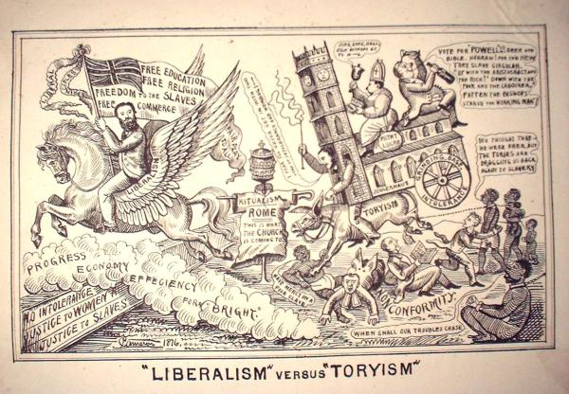
CLASSICAL LIBERALISM

Slide 37
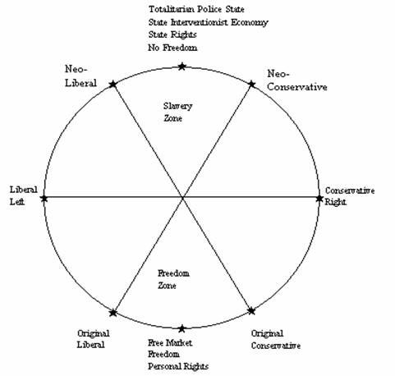
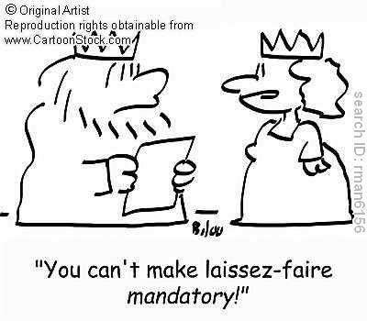
LIBERALISM

Slide 38
THE “L” WORD: MODERN LIBERALISM IN THE US
POLITICALLY LEFT, Democratic party
Greater role for the state or government in the economy and in limiting inequality (similar to SOCIAL DEMOCRACY)
Pro-taxes, pro-Welfare State
Social Liberalism: political culture that values newer social values as opposed to traditional ones and the governements’ reponsibility to protect these (Peace in foreign policy and diplomacy, minority rights, gay rights, multi-culturalism, diversity, racial equality, affirmative action, pro-choice, pro-immigrant, etc.)
Criticized for urging POLITICAL CORRECTNESS and in their zeal for being OPEN-MINDED, legislating new morality standards

Slide 40
LIBERALISM: REDUX
As a political attitude: favors slow, gradual, evolutionary change
As a political ideology in the US: favoring greater state role in limiting inequality or “social democracy”
As a political ideology in the rest of the world (not USA): favoring free markets and individualism, accepting greater inequality
As a political economy: favoring a limited state role in the economy
NEO-LIBERALISM: championing return to liberalism or LAISSEZ-FAIRE CAPITALISM as political economy in the rest of the world as prescription for prosperity, “Washington Consensus,” Milton Friedman & Chicago Boys, privatization, free trade, no tariffs, taxes applied in government and combat corruption, etc.

Slide 41
COMMUNISM
Equality over freedom→ “Equality of result” over “Equality of Opportunity”
Rejects personal freedom bc it does not ensure prosperity for the majority.
Competition for scarce resources results in a small group controlling both govt and economy, not fair. Liberal democracies created by the rich to protect the rights and property of rich.
Takeover of all resources by the state, in order to eliminate inequalities and exploitation and insure trie economic equality for the whole. Private ownership abolished.
Individual liberties must give way to the needs of society as a whole (this is trie democracy)
Never really achieved...as least not as Marx conceived it.

Slide 42
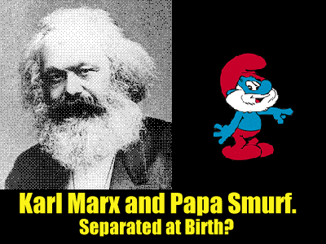
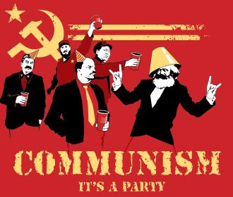
La, la, la, la, la, la...

Slide 43
SOCIALISM or SOCIAL DEMOCRACY
Shares value of equality with communism, but is also influenced by the liberal value of freedom.
Accept and promote private ownership and free market principles
Believe state has a strong and important role to play in regulating the economy and providing benefits to the public in order to ensure some measure of equality and the common good.
Socialism is stronger in Europe...most democracies in Europe accept a large degree of it.

Slide 44
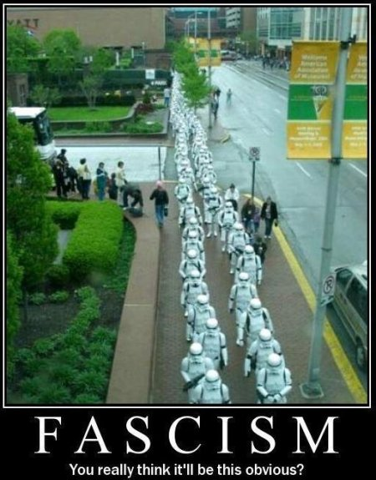
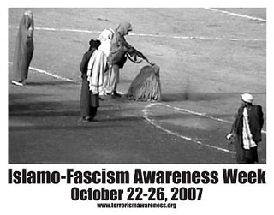
FASCISM
NOT COMMUNISM, but both devalue the idea of individual freedom.
Fascism says NO to equality, accepts idea that people and groups exist in degrees of inferiority and superiority
Fascism says YES to state having the right and responsibility to mold society and economy and eliminate obstacles (including people) that could weaken the state or economy.
Authoritarian state makes superiority and fascism possible
EX: Nazi Germany...no current regimes but it is still an influential ideology, Islamo-fascism

Slide 45
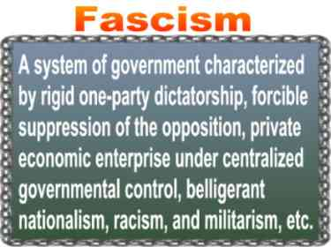

Slide 46
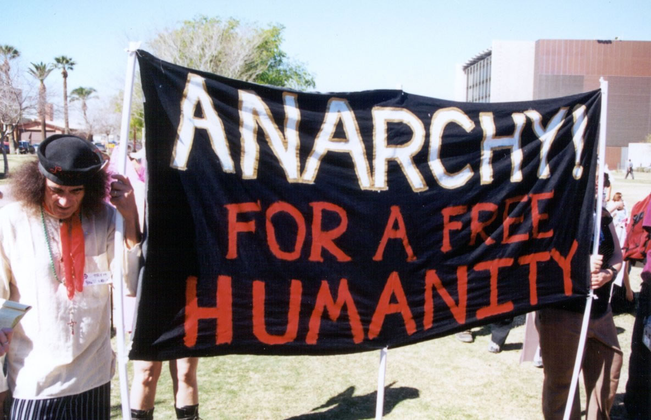
ANARCHISM
FREEDOM AND EQUALITY, no state or property!
Stresses the elimination of state and private property as a way to achieve both freedom and equality for all
Believes high degree of personal freedom and social equality is possible
Great for bringing about revolution and change, once it institutionalizes it doesn’t really exist... So it is a transition ideology, never fulfilled as endgoal.

Slide 47
TRADITIONAL IDEOLOGY: RELIGIONS
Religions have always been an important source of group idenity and continue to be today
Resurgence of religious ideology→ fundamentalism
Many advanced democracies (like US): Separation of Church vs. State
Religion can still serve as basis for interest groups and associations in civil society
European countries→ many still have state religion, yet societies largely secularized and religious leaders do not equal political leaders.
Religion plays a role in all 6 countries we study from Falun Gong in China to Orthodox Church in Russia to Shia Islam in Iran

Slide 48
TOPIC THREE: POLITICAL & ECONOMIC CHANGE
Comparativists look at causes and forms of change, also look at impacts on policymaking process
Political and economic changes often occur together and influence one another
One type of change without the other creates tensions with serious consequences
CHINA→ major, rapid economic changes should start pressuring government to institute political situations
Can authoritarian governments effectively guide market economics?

Slide 49
TYPES OF CHANGE
REFORM
REVOLUTION
COUP D’ÉTATS

Slide 50
Type of Change: REFORM
Reformers want to change methods that political and economic leaders use to reach goals society accepts instead of advocating overthrow of basic political or economic institutions.
Ex Change business practices in order to preserve real competition in a capitalist country or maybe they want government to become more proactive in preserving the environment.

Slide 51
Type of Change: REVOLUTION
Revolution: major revision or overthrow of existing institutions, usually impacts more than one area of life.
Ex: Industrial Revolution altered economies of Europe from feudalism to capitalism, eventually changed their political systems transportation, communication, literature, cities and social class. French and American Revolutions aimed at political systems, but they also changed economies and societal practices in both countries and ideas and influence spread.

Slide 52
Type of Change: COUP D’ÉTATS
Most limited of the 3 types of change, literally means “blow to the state”
Replace leadership of a country with new leaders
Usually occur in countries where government institutions are weak and leaders have taken control by force
Leaders are challenged by others who use force to depose them
Most coups are carried out by military, but new leaders are always vulnerable to being overthrown by yet another coup

Slide 53
ATTITUDES TOWARD CHANGE
Radicalism
Liberalism
Conservatism
Reactionary Beliefs

Slide 54
Attitude Toward Change: Radicalism
Belief that rapid, dramatic changes need to be made in existing society, including political system.
Usually believe current system cannot be saved and must be overturned and replaced with something better
Often are leaders of REVOLUTION
Ex: radicalism prevailed in Russia in 1917 when old tsarist regime replaced by communist USSR

Slide 55
Attitude toward Change: Liberalism
Supports reform and gradual change, no revolution
Don’t confuse liberalism as attitude toward change with liberalism as political ideology
Don’t believe political and economic systems are broken, but they believe they need to be repaired or improved
They may support the notion that eventual transformation needs to take place, but they almost always believe that gradual change is best

Slide 56
Attitude Toward Change: CONSERVATISM
Much less supportive of change in general than radicals or liberals, support status quo
Change is disruptive and they emphasize the fact that it sometimes brings unforeseen outcomes
State and regime are very important sources of law and order that might be threatened by making significant changes in the way they operate
Legitimacy might be undermines, as well as basic values and beliefs of the society.

Slide 57
Attitude Toward Change: REACTIONARY BELIEFS
Protect against change like conservatives but go a step further
Oppose revolution and reform, but they also find status quo unacceptable
Want to turn back the clock to an earlier era and reinstate political, social and economic institutions that once existed or are imagined to have existed
One thing in common with radicals: both groups generally more willing to use violence to reach their goals

Slide 58
THREE TRENDS
DEMOCRATIZATION
MARKETIZATION
REVIVAL OF ETHNIC OR CULTURAL POLITICS

Slide 59
TREND: DEMOCRATIZATION
More and more nations are turning toward popular government, some form of democracy
Growing commonality among nations→ democratization
Essential requirement for democracy: Competitive Elections that are regular, free and fair (elections that offer the possibility that the incumbent govt could be defeated)
By this standard many “DEMOCRACIES” are dubiously democratic, neither clearly democratic or clearly undemocratic (Ex: Russia, Nigeria, Indonesia)

Slide 60
LIBERAL DEMOCRACIES
COMPETITIVE ELECTIONS PLUS…
CIVIL LIBERTIES: freedom of belief, speech, assembly
RULE OF LAW: equal treatment of citizens & due process
NEUTRALITY OF THE JUDICIARY: judicial review or other checks on the abuse of power
OPEN CIVIL SOCIETY: that allows citizens to lead private lives and mass media to operate independent of government
CIVILIAN CONTROL OF THE MILITARY: restricts likelihood of military coup

Slide 61
ILLIBERAL DEMOCRACIES
Countries that have regular, free, and fair competitive elections, but are missing these other qualities such as civil liberties, rule of law, etc.
Name some illiberal democracies?

Slide 62
THREE WAVES OF DEMOCRATIZATION
Huntington’s theory
First Wave developed gradually over time since the revolutions of the late 18th Century
Second Wave occurred after Allied victory in WWII and continued until the early 1960s, post-colonialism→ decolonization
THIRD WAVE: defeat of dictatorial or totalitarian rulers from South America to Eastern Europe to parts of Africa since 1970s

Slide 63
WHY THIRD WAVE OF DEMOCRATIZATION?
Loss of Legitimacy by both right and left wing authoritarian regimes
Expansion of the urban middle class in developing countries
Emphasis on HUMAN RIGHTS by USA and EU
“Snowball effect” when one country in a region becomes democratic, influences others to do so
EX: POLAND’S INFLUENCE OF OTHER EASTERN EUROPEAN NATIONS IN 1980s

Slide 64
DEMOCRATIZATION (CONT)
POVERTY: great obstacle to democratization because it blocks citizen participation in government
Huntington’s gauge of Democratic Stability: AT LEAST two successive peaceful turnovers of power
Authoritarian regime may transition to democracy as result of “trigger event” such as economic crisis or military defeat
Political discontent fueled if crisis is preceded by period of relative improvement in standard of living→ REVOLUTION OF RISING EXPECTATIONS
Democratization really beings when conditions are accompanied by a willingness on the part of the ruling elite to accept power-sharing arrangements, as well as a readiness on the part of the people to participate in the process and actively support regime

Slide 65
TREND: MARKETIZATION
Movement toward Market Economies in 20th and early 21st centuries
Disagreement about relationship between democratization and marketization→ is their causation?
We often see both occurring (Mexico since 1980s), but other examples provide contradictory evidence (China since the late 1970s)
Marketization= state’s recreation of a market in which property, labor, goods and services can all function in a competitive environment to determine their value.
Privatization = transfer of state-owned property to private ownership.

Slide 66
TYPES OF ECONOMIES
Command Economy: socialist principles of centralized planning and state ownership…now fading, except in combination with market economies (Ex: China, Cuba, Vietnam)
Market Economy: no or little significant control from the government, more individualistic (Ex: USA)
Mixed Economy: one that allows for significant control from central government (Ex: GERMANY→ social market economy, team-oriented, emphasizes cooperation between management and labor

Slide 67
Factors that promote marketization:
BELIEF THAT GOVT IS TOO BIG: anti-big govt movements began in the US and many W European countries in 1980s after periods of inefficiency and stagnation in 1970s. (Neoliberalism, Milton Friedman’s Chicago Boys, Ronald Reagan and Margaret Thatcher came to power with this philosophy)
LACK OF SUCCESS OF COMMAND ECONOMIES> collapse of USSR reverberated around the world, Eastern Europe satellite states moved from command to capitalism. China, slowly infused capitalism to avoid collapse, “Socialist market economy”

Slide 68
ECONOMIES CONTINUUM—from Command to Mixed to Market
All economies fall somewhere on the continuum between command and market systems—there are no pure command or pure market economies.

Slide 69
Command Economies today

Slide 70
TREND: REVIVAL OF ETHNIC OR CULTURAL POLITICS
Few political scientists predicted that FRAGMENTATION (divisions based on ethnic or cultural identity) would become increasingly important in world politics
NATIONALISM (identities based on nationhood) seemed to be declining due to GLOBALIZATION
Nationality questions certainly impacted Gorbachev’s attemps to revive the USSR and national identities are still strong in much of the world
POLITICIZATION OF RELIGION dominated world politics in early 21st century, caught Western political scientists off guard. Middle East—political terrorism carried out in name of Islam and framing of modern international interactions as CLASH OF CIVILIZATIONS (Huntington) between Islam and West (Christianity)

Slide 71
Huntington’s Clash of Civilizations
Most important and dangerous future conflicts based on clashes of civilizations, not on socioeconomic or even ideological differences
Divides world into 8 different civilizations or cultural areas: West, Orthodox world (Russia & E Europe), Islamic countries, Latin America, Hindu, Confucian, Buddhist, Japan, (and Africa?)
Critics: Distorts cultural divisions, underestimates cultural conflicts within nations
One thing is true... ETHNIC OR CULTURAL POLITICS has been revived (whether it is on civilizational fault lines or not)

Slide 72
TOPIC FOUR: CITIZENS, SOCIETY & THE STATE
SOCIAL CLEAVAGES: divisions theoretically out of the realm of politics such as religion, ethnic groups, race, social and economic classes. These have a huge impact on policymaking.
Bases of social cleavages: What mix of social classes, ethnic and racial groups, religions, languages does a country have? How deep are these cleavages and to what degree do they separated people or form social boundaries? Which cleavages have the most significant impact on the political system?
Cleavages and political institutions: How are the cleavages expressed politically? Is political party membership based on cleavages? Do these cleavages block some groups from fully participating in government? Do political elites usually come from one group or another?

Slide 73
Comparing Citizen/State Relationships
ATTITUDES AND BELIEFS OF CITIZENS: Do citizens trust their govt? Do they believe govt cares about what they think? Do citizens feel govt affects their lives in significant ways?
POLITICAL SOCIALIZATION: How do citizens learn about politics in their country? Does electronic and print media shape their learning? If so, how much of their effort might you call “propaganda”? How do children learn about politics?

Slide 74
TYPES OF POLITICAL PARTICIPATION:
Authoritarian governments: citizens contact govt through SUBJECT ACTIVITIES that involve OBEDIENCE.
Ex: obeying laws, following military orders, paying taxes.
Democratic governments: citizens play more active role in political process.
VOTING is most common type of participation.
Other types of participation: working for political candidates, attending political meetings or rallies, contributing money to campaigns, joining political clubs or parties, joining interest groups that work directly on influencing political process or policymaking.

Slide 75
More Comparing Citizen/State relations
VOTING BEHAVIOR: Do citizens in the country have regular elections? If so, are the elections truly competitive? If not, what si the purpose of elections? What citizens are eligible to vote and how many actually vote? Do politicians pay attention to elections? Do elections affect policymaking?
FACTORS THAT INFLUENCE POLITICAL BELIEFS AND BEHAVIORS: consider the important cleavages in the country, do they make a difference in citizen’s pol beliefs and behaviors?
Ex: Do lower classes vote for one political party or the other? Are women’s beliefs and behaviors different from those of men? Are younger people as likely to vote as older people? Do people in rural areas participate in government?

Slide 76
SOCIAL CLEAVAGES
SOCIAL CLASS: class awareness declined in industrial and post-industrial societies, still an important base for cleavages.
Huge in Great Britain where traditionally middle class voters supported Tories and working class voters supported Labour Party.
In LDCs class tensions may appear between landless peasants and property owners
India, vestiges of caste system (now illegal) slowed India’s movement toward full democracy and political participation.
ETHNIC CLEAVAGES: Clearly most divisive and explosive social cleavages in countries at all levels of development.
Ethnic clashes cause of several full-scale civil wars in the former Yugoslavia, some of the former USSR republics, and African countries such as Liberia, Rwanda and Angola.
Based on different cultural identities including religion and language and are important to consider in APCG.

Slide 77
SOCIAL CLEAVAGES (cont)
RELIGIOUS CLEAVAGES: religious differences can be closely intertwined with ethnicity. However religious differences can exist among people of similar ethnic backgrounds.
EX: conflict in N Ireland has a strong religious dimension with the Irish nationalists being ardent Catholics and the loyalists strong Protestants.
EX: USA between fundamentalist and non-fundamentalist Christians
REGIONAL CLEAVAGES: diffeing political values and attitudes characterize people living in different geographic regions. These populations compete for government resources such as money, jobs and development projects. Regional differences are often linked to varying degrees of economic development.
Ex: Nordeste vs. South of Brazil, regional conflicts in Nigeria based on economic inequalities led to secession of BIAFRA and Civil War.

Slide 78
CLEAVAGES: CROSS-CUTTING vs. COINCIDING
Coinciding Cleavages: When every dispute aligns the same groups against each other. This is very divisive and can lead to major conflicts.
Ex: Northern Ireland. Catholics v. Protestants, Nationalists v. Loyalists, Irish v. British, working class and poor v. Middle class and wealthy, no representation v. Political elites... These cleavages are all pitting the same people against each other!
Cross-cutting Cleavages: divide society into many potential groups that may conflict on one issue but cooperate on another and they tend to keep social conflict to more moderate levels.
Ex: Regional cleavages in Mexico divide society, Social Class would divide society differently, PAN vs. PRI vs. PRD along, different lines urban vs. Rural. While cleavages sometimes coincide, not always.
Ex: Racial cleavages in the US—blacks v. Whites v. Latinos, democrats v. Republicans, rich v. poor, working class v. Middle class, urban v. rural, south v. North, south v. Coasts v. Midwest v. Rust Belt, Catholics v. Protestants,

Slide 79
SOCIAL MOVEMENTS
Organized collective activities that aim to bring about or resist fundamental change in an existing group or society.
Try to influence political leaders to make policy decisions that support their goals
Step outside traditional channels to bring abot social change
Take stands on issues that push others in mainstream society to reconsider their positions
Ex: Leaders in women’s suffrage movement in Britain and USA considered radicals, but goals eventually accomplished.
Modern Civil Rights Movement in US, collective action that influences state, local and national govts to support racial equality, ANC wanted to overthrow the state supported system of apartheid, finally had them ligt the ban, etc. Even “failed” social movements can often influence political opinion.

Slide 80
CIVIL SOCIETY

Slide 81
CIVIL SOCIETY
Organizations outside the gov tlarger than family that help people define and advance their own interests
Stronger in liberal democracies where individual freedoms valued and protected
Orgs may represent class, religious or ethnic interests or they may cross them. They create strong personal bonds that exist outside of govt controls.
Civil Society helps define people’s relationship to and role in politics an community affairs
Some groups inherently apolitical, still are important to liberty because they allow people to articulate and promote what is important to them
Civil Society checks power of the state, prevents “tyranny of the majority”
Advocacy groups, social networks, media...all part of CS
Name some groups that are part of civil society in Brazil, in the United States

Slide 82
21st Century: GLOBAL CIVIL SOCIETY
COSMOPOLITANISM: universal political order that draws its identity and values from everywhere is emerging
NGOs are important part of global civil society and there are also informal civil society as people find common interests with other people who live in other corners of the globe.
NGOS: national and international groups, independent of any state, that pursue policy objectives and foster public participation.
Human rights and environmental groups provide international pressures that have impacted govt-citizen relations.
Societal globalization changes def of who is US and who is THEM and reshapes a world previously defined in nationalistic terms.
How do social networks and social media impact global civil society?

Slide 83
Civil Society in Authoritarian States
By their very nature, authoritarian states don’t encourage civil society as may be threat to power
CS doesn’t necessarily disappear even in harshest authoritarian environments (EX: survival of Russian Orthodox Church and social reform movements in Eastern Europe during Communist rule.

Slide 84
Civil Society in LDCs and NICs
Civil Society is generally weak in LDCs and NICs
Individuals tend to be divided by ethnic, relicious, economic, or social boundaries and don’t identify with groups beyond their immediate surroundings that could help them articulate their interests to the govt.
Civic education is important so population knows what their democratic rights are and how to use them.
Positive sign for CS in LDCs is more women participating in NGOs, esp that deal with health, gender, environmental and poverty issues.

Slide 85
TOPIC FIVE: POLITICAL INSTITUTIONS
Structures of a political system that carry out the work of governing
Some structures more elaborate than others
Just because we have the same type of institutions in 2 countries doesn’t meant they each serve the same functions for their political system (Legislature in one country may have much more power than in another country).
Common political institutions: legislatures, executives, judicial systems, bureaucracies, armies, etc.

Slide 86
Levels of Government
All states fall on a continuum from the most concentrated amount of power to the least.
Unitary system: concentrates all policymaking powers in one central geographic place (most countries are unitary states)
Federal system divides the power between the central government and sub-national units. (often used in countries with large geographic areas and different regions or with very different groups in their population, Ex: USA, Brazil, Russia, Nigeria)
Confederal system: spreads the power among many sub-units (such as states) and has a weak central government. (this usually leads to a an inefficient government, Ex: CIS after fall of USSR, Articles of Confederation, Confederacy during US Civil War)

Slide 87
SUPRANATIONAL ORGANIZATION and GLOBALIZATION
Supranational Organizations: go beyond national boundaries, reflect a trend toward INTEGRATION.
INTEGRATION:
a process that encourages states to pool their sovereignty in order to gain political, economic and social clout.
Binds states together with common policies and shared rules
Ex: EU, NAFTA, OPEC, NATO, UN
GLOBALIZATION→ integration of social, environmental, economic and cultural activities of nations resulting from more contact.
FRAGMENTATION→ people base their loyalty on ethnicity, language, religion or cultural identity
Transcend political boundaries between individual countries, change the nature of sovereignty.

Slide 88
CENTRIPETAL FORCES→ UNIFY, globalize
CENTRIPETAL FORCES: Bind together the people of a state, strengthen it.
Nationalism is a centripetal force, encourages allegiance to a country, promotes loyalty and commitment, encourage people to obey law and accept country’s ideologies, use of symbols (flags, rituals, holidays) to promote national unity.
Institutions (schools, armed forces, religion, fast and efficient transportation and communication systems, national broadcasting companies, etc.) are centripetal forces.
These make it easier for the government to reach all of its citizens and make citizens have a more common identity

Slide 89
Centrifugal forces→ divide, de-stabilize country
If country not well organized or governed→ can lose loyalty of its citizens
Weak institutions→ fail to provide cohesive support govt needs
Strong institutions may also challenge the government for the loyalty of the people (Ex: 1917 USSR, Russian Orthodox church challenged Soviet govt, that is why it was banned, Church was a CENTRIFUGAL FORCE)
Nationalism can be destabilizing force if different ethnic groups within country have more loyalty to ethnicity than to the state and its govt→ Separatist movements (were centrifugal forces in USSR, Lithuanians, Latvians, Georgians, Ukrainians, Armenians challenged govt)
Peripheral locations, social and economic inequality→ Strengthen separatist movements

Slide 90
DEVOLUTION
Devolution of govt powers to sub-government is usually a reaction to centrifugal forces that divide and destabilize.
THREE TYPES OF DEVOLUTIONARY FORCES:
ETHNIC FORCES→ ethnic group shares identity based on a unique mixture of language, religion and customs. When state has strong ethnic groups with identities that differ from majority, it can be a centrifugal force. ETHNONATIONALISM→ tendency for ethnic group to see itself as a distinct nation with a right to autonomy or independence promotes devolution.
Ex: French Canadians in Quebec, Wales, Scotland and Northern Ireland, Yugoslavia into the 1990s broke it into Slovenia, Croatia, Bosnia, Macedonia and Serbia-Montenegro

Slide 91
DEVOLUTION (cont)
ECONOMIC FORCES→economic inequalities may destabilize a nation-state, esp if inequalities regional. (Ex: Northern vs. Southern Italy→ Ancona line, led to “Northern League”, Catalonia in Spain→17% population, but 40% of economy, Santa Cruz in Bolivia, etc.)
SPATIAL FORCES→ spatially, devolutionary events usually occur on the margins of the state. Distance, remoteness & peripheral location promote devolution, esp if water, desert or mountains separate areas from center of power. Also, neighbor nations may support separatist objectives.
(EX: Puerto Rico, Northern Ireland, Santa Cruz vs. La Paz in Bolivia, etc.)

Slide 92
EXECUTIVES
Executive office carries out the laws and policies of a state.
TWO ROLES: HEAD OF STATE & HEAD OF GOVERNMENT
Head of State: symbolizes country and represents people, nationally and internationally, may or may not have any real policymaking power.
Head of Government: deals with everyday task of running the state and usually directs the activities of other members of the executive branch.
Distinction is clearly seen in Britain, monarch→head of state, PM→head of govt and Japan→ emperor and PM
USA→both roles in one position, President
Russia and France→ president head of state with strong powers, PM is head of govt with subordinate powers
Italy & Germany→ President is head of state with weak powers and PM is stronger head of government

Slide 93
Functions of the Chief Executive
Initiates new policies and plays important role in adoption.
Presidential system→ president usually has power to veto legislation, not so in parliamentary system, but not as necessary either
Political executive: oversees policy implementation and can hold other officials in executive branch accountable for their performance
Central decisions in foreign policy crisis generally made by chief executive

Slide 94
THE CABINET
Parliamentary systems→
CABINET is most important collective decision making body. Ministers head all of major departments of exec branch, led by Prime Minister “first among equals”
Ministers are leaders of the majority party
If multi-party system or no clear majority→ Cabinet Coalition
Presidential Systems→
President chooses cabinet members from almost any areas of political life and appointments may have to be approved by legislature (like US Senate).
Since cabinet leaders not necessarily party leaders or members of legislature, they are more independent from president, but president has power to remove them from office so they can’t stray too far.

Slide 95
BUREAUCRACIES
Agencies that implement government policy, usually are part of the executive branch.
Size has increased as govts increase efforts to improve health, security and welfare of populations
Max Weber created classic conception of bureaucracy as a well-organized, complex machine that is a “rational” way for a modern society to organize its business…not necessary evils, best organizational response to a changing society
Basic characteristics:
HIERARCHICAL AUTHORITY STRUCTURE—top down chain of command
TASK SPECIALIZATION—division of labor where everyone has specialized job
EXTENSIVE RULES—clearly written, well-established
CLEAR GOALS—defined set of goals for whole organization
MERIT PRINCIPLE—merit based hiring and promotion, no nepotism unless best qualified
IMPERSONALITY—job performance judged by productivity

Slide 96
BUREAUCRACIES IN DEMOCRACIES
DISCRETIONARY POWER: power given to bureaucrats to make small decisions in implementing legislative and executive divisions, these can arguably add up to significant policymaking influence, even though elected officials should have this influence.
Bureaucracies provide stability to the system, stay on through changes in elected leadership positions, provide continuity in policymaking process.

Slide 97
BUREAUCRACIES IN AUTHORITARIAN REGIMES
Bureaucracies don’t only manage economy, but directly control vast resources, including human labor (ex: under Stalin’s rule, number of prisoners in labor camps under secret police administration increased dramatically).
Patronage System, where political supporters receive jobs in return for assistance in getting president elected.
Bureaucratic-Authoritarian Regimes in Brazil, Argentina, Chile and Paraguay during 1960s and 1970s.
Military regime that included military officers and civilian bureaucrats/technocrats.
Coalition seized control of govt and decided which groups could participate
Authoritarian leaders seen as modernizers trying to improve economy, controlled partly in the name of efficiency—democracy was inefficient, obstacle to modernization.

Slide 98
Bureaucracies: Common Characteristics
Non-elected positions
Impersonal, efficient structures
Formal qualifications for jobs
Hierarchical organization
Red tape/inefficiency

Slide 99
LEGISLATURE
Branch of government in charge of MAKING LAWS
Formal approval usually required for major public policies
In authoritarian states, legislatures dominated by the executive
Over 80% of the countries in the UN have legislatures→ implies that legitimate govt today should formally include a representative popular component.

Slide 100
BICAMERALISM
Two chambers or two houses
System traced back to Britain’s House of Lords and House of Commons, upper and lower house (doesn’t necessarily imply power, depends on country)
Why do most countries practice bicameralism?
If country federalism, bicameralism allows for on house to represent regional govts and local interests. Seat in the other are usually determined by the population, so it serves as a more direct democratic link to voters
Counterbalances disproportionate power of any region (Ex: CA and TX in USA)
Disperses power requiring both houses to approve legislation
Upper house can be a “Cooling mechanism to slow down impulsive actions on the hotheaded lower house”

Slide 101
FUNCTIONS OF LEGISLATURES
Formulate, debate and vote on political policies
Control the budget (fundraising and spending)
May appoint officials in the executive and judicial branches or vote to approve them
May serve as court of appeal (like British House of Commons)
Elite recruitment

Slide 102
JUDICIARIES
Role of judiciary varies a lot between one country and another
Courts in authoritarian systems have little or no independence
Courts that decide guilt or innocence date back to medieval England
Constitutional courts that serve to defend democratic principles against infringement by private citizens and govt, highest institution that rules on constitutionality
JUDICIAL REVIEW→ mechanism allows courts to impose restrictions on what political leaders do, review laws and actions for their constitutionality

Slide 103
LINKAGE INSTITUTIONS
Groups that connect government to its citizens (Ex: political parties, interest groups, etc.)
Larger the population, the more complex the governments policymaking activities, the more likely it is to have well-developed linkage institutions are.

Slide 104
PARTIES
Bring different people and ideas together to establish means by which majority can rule
Provide labels for candidates that help citizens decide how to vote
Hold politicians accountable to electorate and other political elites
Multi-party systems (most countries), two party systems (USA)
One party system (Communist states, Mexico under PRI, etc.)

Slide 105
Two party system
Rarity, only in 15 countries in world
USA—two major political parties→ Republicans and Democrats, minor parties exist, but don’t win national elections
WHY? PLURALITY ELECTORAL SYSTEM (first past the post wins)
European countries have multiparty systems→ Proportional Representation

Slide 106
ELECTORAL SYSTEMS
Rules that decide how votes are cast, counted and translated into seats in a legislature, how populations are divided by electoral boundaries, etc.
THREE TYPES:
PLURALITY SYSTEM
PROPORTIONAL REPRESENTATION
MIXED SYSTEM

Slide 107
FIRST PAST THE POST→ SMDP
FIRST PAST THE POST: (USA, India, UK) divide constituencies into SINGLE MEMBER DISTRICTS in which candidates compete for a single representative’s seat.
PLURALITY SYSTEM→ winner takes all, don’t need majority win, simply more votes that the other guys
Perpetuates 2 party system!

Slide 108
PROPORTIONAL REPRESENTATION
PROPORTIONAL REPRESENTATION→ creates multi-member districts in which more than one legislative seat is contested in each district
PR→ Voters cast ballots for a party instead of a candidate and percentage of votes a party receives determines how many seats party will gain in legislature (EX: South Africa, Italy, Germany, etc.
Multiple political parties

Slide 109
MIXED SYSTEM
Combines FPTP and PR (Mexico and Russia, in Mexico 300 of 500 in Chamber of Deputies are elected through winner take all and 200 are through PR)
In-between number of political parties

Slide 110
ELECTORAL SYSTEMS
Plurality Systems→ encourage large, broad based parties, because no matter how many people run, the person with the most votes wins, parties act as umbrellas
PR systems→ encourage multiple parties because they have a good chance of getting their representative elected even if they don’t “WIN” district. Allows minor parties to form coalitions to create majority vote to pass legislation
Democracies also vary in types of elections→ presidential vs. parliamentary systems

Slide 111
Election of Public Officials
Number of elected officials varies widely
Even in a unitary state, many local and regional officials are directly elected
Legislators are usually directly elected on the regional and national levels.
Now in Europe, citizens also elect representatives to the EU Parliament.
Lower houses more likely directly elected than others

Slide 112
REFERENDUM
Countries have option of allowing public votes on a particular policy issues
National ballot called by government on a policy issue→ REFERENDUM
USA & CANADA, referenda only exist at state and local level
France and Russia, president can call referenda and they have important consequences (Ex: Constitution of 1993)
PLEBISCITE—ballot to consult public opinion in a nonbinding way

Slide 113
INITIATIVE
Vote of a policy initiated by the people
Less common than referendum
Must propose and issue for nation-wide or state-wide vote and its organizers must collect a certain number of supporting signatures from the public, then the govt has to schedule a vote.

Slide 114
Political Elites and Recruitment
Every country must establish methods of ELITE RECRUITMENT or ways to identify and select people for future leadership positions.
SUCCESSION→ process that determines the procedure for replacing leaders when they resign, die or are no longer effective

Slide 115
TOPIC SIX: PUBLIC POLICY
ECONOMIC PERFORMANCE
SOCIAL WELFARE
CIVIL LIBERTIES, RIGHTS and FREEDOMS
ENVIRONMENT

Slide 116
ECONOMIC PERFORMANCE
GDP: all goods and services produced by a country’s economy, excluding income citizens and groups earn outside country
GNP: GDP + income citizens earned outside the country
GNP per capita: divides GNP by population
PPP: Purchasing Power Parity is like GDP but it takes into consideration what people can buy using their income in the local economy
Trade→ Imports and Exports

Slide 117
SOCIAL WELFARE
Includes health, employment, family assistance, literacy rates, income distribution, life expectancy and education levels, etc.
GINI INDEX: measures economic inequality in society
HDI: Human Development Index measures the well-being of a country’s people factoring in adult literacy, life expectancy, educational enrollment and GDP

Slide 118
CIVIL LIBERTIES, RIGHTS & FREEDOMS
Civil Rights→ promotion of equality
Civil Liberties→ promotion of freedom
Most constitutions pay lip service to them (whether they are liberal democracies or communist, post-communist, LDCs, etc.)
Freedom House rankings, organization that studies democracy around the world ranks countries on a 1-7 freedom scale,1 is most free, 7 is least free

Slide 119
ENVIRONMENT
One of state’s modern functions is protection of the environment, especially European countries
GREEN PARTIES
Promotion of global civil society operating across national borders to deal with environmental issues
Need a good GREEN indicator!

